Slide 1
Section 13-4: The Costs and Advantages of Home Ownership
Understand the characteristics of fixed rate mortgages.
Be familiar with the recurring costs of home ownership – taxes and insurance.
Be familiar with amortization of a mortgage – how a payment is split between principal and interest

Slide 2
Fixed-Rate Mortgages
A mortgage is a loan:
For buying a home, property, or real estate,
For a “substantial” (large) dollar amount,
To be paid back over a long period of time,
Where the property itself is security for the loan.
(also known as deed of trust or security deed)

Slide 3
Fixed-Rate Mortgages
Term of the mortgage – the time until the final payoff of the loan.
Down payment – the portion of the purchase price of the home which the buyer pays up front
Principal amount of the mortgage (amount borrowed or amount financed) – subtract the down payment from the purchase price.

Slide 4
Fixed-Rate Mortgages
With a fixed-rate mortgage,
the interest rate will remain constant throughout the term,
initial principal balance, together with interest due on the loan, is repaid to the lender through regular (constant) periodic (we assume monthly) payments.
This is called amortizing the loan.

Slide 5
Regular Monthly Payment
The regular monthly payment required to repay the loan of P dollars, together with interest at an annual rate r, over a term of t years, is given by
We won’t be using this “long formula.” I just wanted you to see it...

Slide 6

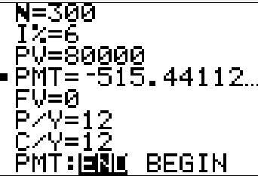

Example: Monthly Mortgage Payment
Find the monthly payment necessary to amortize an $80,000 mortgage at 6% annual interest for 25 years.
Solution
25 years × 12 monthly payments

Slide 7
Taxes, Insurance, and Maintenance
The primary financial considerations for most new
homeowners are the following.
1. Accumulating the down payment
Having sufficient cash and income to qualify for the loan
Making the mortgage payments

Slide 8
Taxes, Insurance, and Maintenance
Property taxes are collected by your county or local government. Property taxes, and also mortgage interest, are deductible on your income taxes.
Homeowner’s insurance usually covers losses due to fire, storm damages, and other casualties.
Homes also require maintenance, but these costs can vary greatly.

Slide 9
Taxes, Insurance, and Maintenance
Payments of property taxes and homeowner’s insurance are commonly made from a reserve account (also called an escrow or an impound account) maintained by the mortgage lender.
The borrower must pay enough each month, along with amortization costs, so that the reserve account will be sufficient to make payments when they come due.

Slide 10

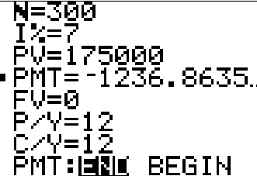
Example: Taxes and Insurance
A couple has a 25-year, $175,000 fixed-rate loan at 7%. In addition, they owe $2800 in annual taxes and $750 annually for homeowner’s insurance. What is their net average monthly expenditure?
Solution First, we determine the monthly mortgage payment before taxes and insurance using the TVM Solver:
So the payment before taxes and insurance is $1236.86.

Slide 11
Example: Taxes and Insurance
Solution (continued)
The monthly mortgage payment is $1236.86.
The added monthly expense from taxes and insurance = ($2800 + $750)/12 = $295.83.
This gives a total net average monthly expenditure of $1532.69.

Slide 12
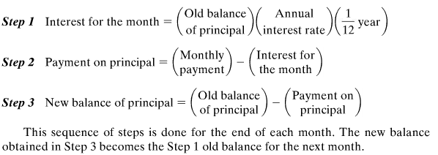
Amortization Schedule
Once the regular monthly payment has been determined, an amortization schedule (or repayment schedule) can be generated. It will show the allotment of payments for interest and principal, and the principal balance, for one or more months during the life of the loan.

Slide 13
Example: Amortization Schedule
Using the information from Slide #6, fill in the table (monthly payment was $515.44). Use next slide for calculations.
For each new payment (for each row):
The monthly interest (Interest Payment) = (balance)(.06)(1/12)
Principal payment = $515.44 – monthly interest.
Payment | Interest Payment | Principal Payment | Balance of Principal
-- | -- | -- | $80,000
1
2

Slide 14
Example: Amortization Schedule
Solution based on monthly payment $515.44, interest rate 6%
Payment | Interest Payment | Principal Payment | Balance of Principal
-- | -- | -- | $80,000
1
2

